Slide 1
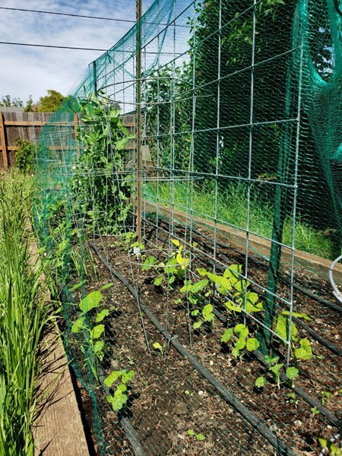
Garden App Demo 1
Group Kira: Daniel Dietrich, Gavin Cyr, Kira Luethe, Richard Williams, Todd Wood

Slide 2


Agenda
Kira- Intro & User Interface
Todd- Plant Search
Gavin – ZIP Code Search
Dan – User Authentication
Richard “Matt” - API

Slide 3

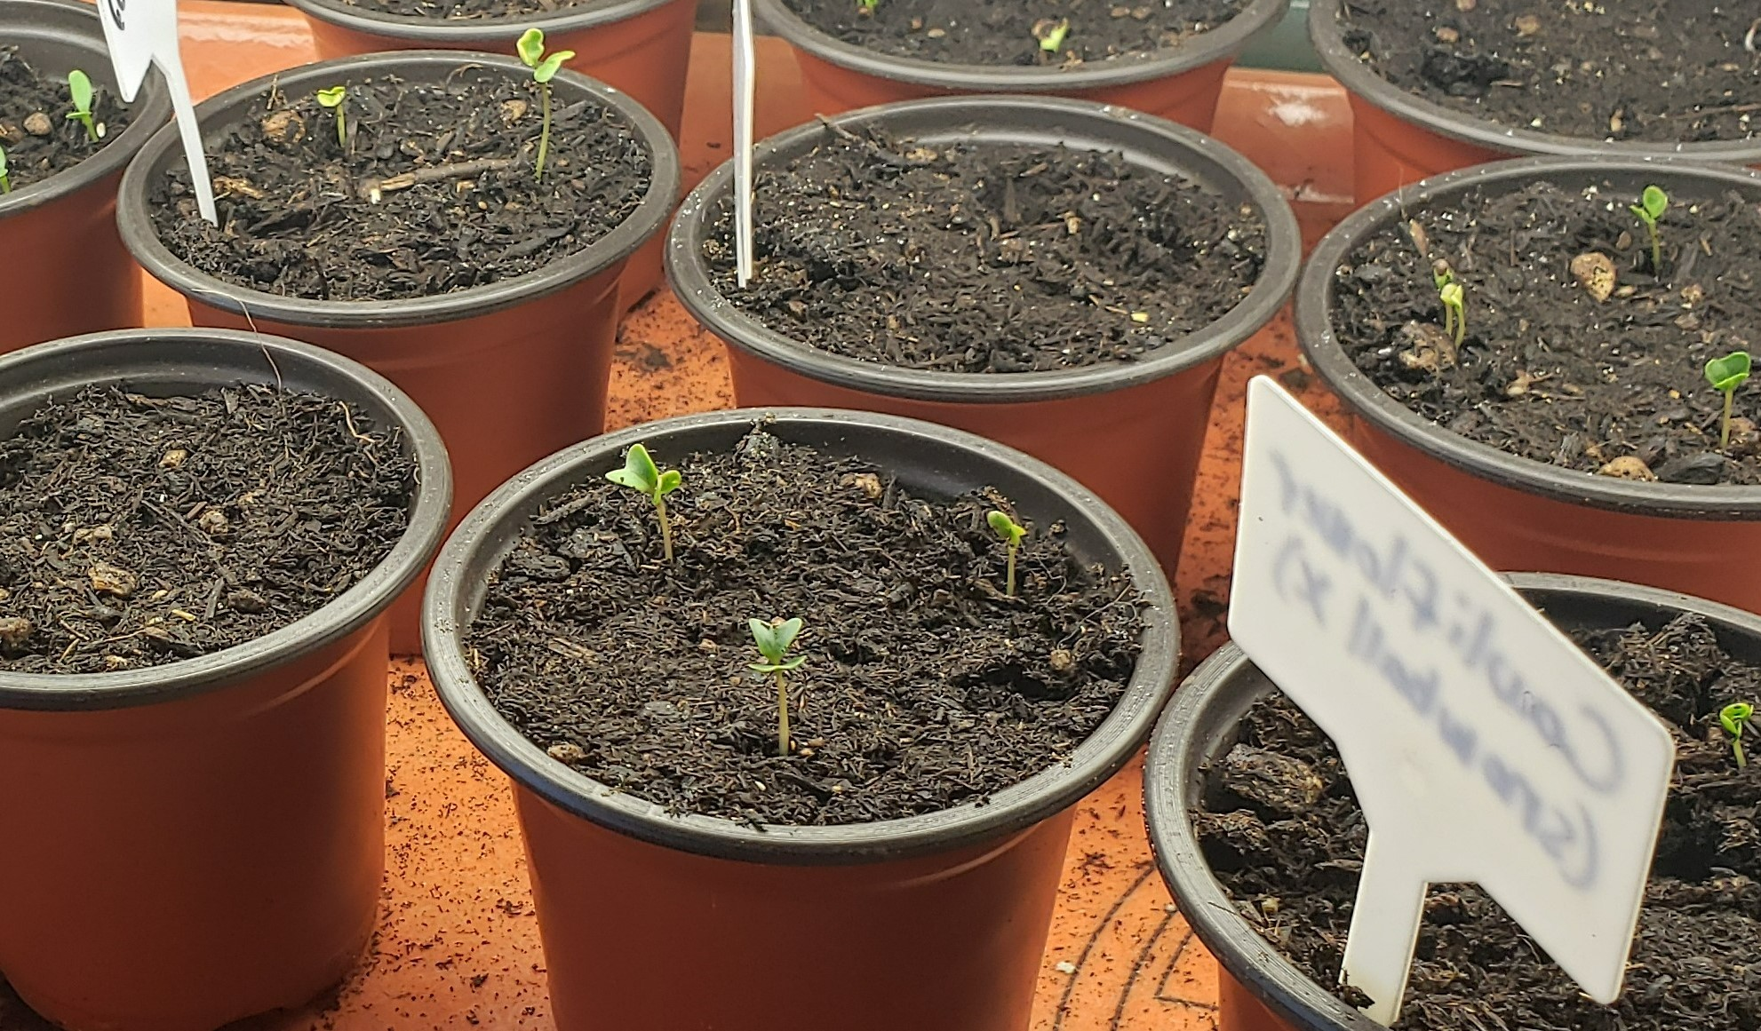
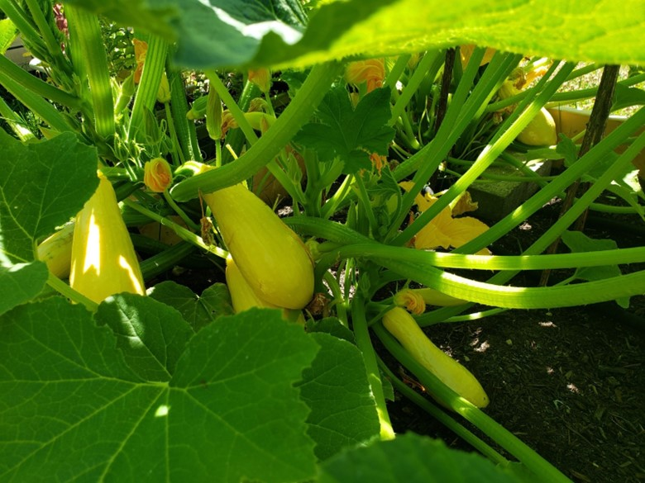
Intro & User Interface
Kira Luethe

Slide 4
Intro & User Interface
What is Garden App?
Features to come
An app designed to help hobby gardeners
Look up plant information
Find information based on USDA Planting Hardiness Zones
Keep track of when users planted their seeds
Expanded interface as other functionality is added
Mobile Friendly user interface

Slide 5
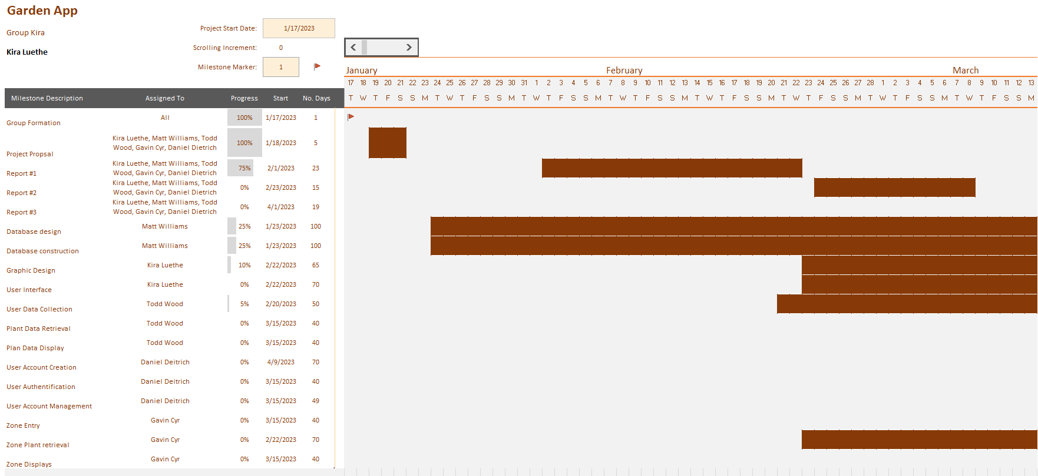
Plan of Work

Slide 6
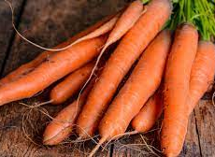
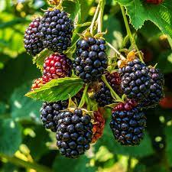
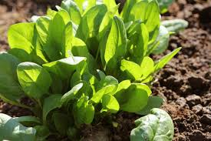
Plant Search
Todd M. Wood

Slide 7
Plant Search Functionality
Purpose & Features:
How it works:
Allows the user to get a list of plants
General Search – no criteria
Search by plant name
Search by plant type
Set the zone and search
Retrieve Stored plants (future)
Calculate when plants will grow (future)
The user enters a plant name, or plant type in the search bar
Or the user enters a zip code and then enters the plant name
The user data is pulled from the page and checked for criteria.
A URL is built based on the entered information
The data is requested using the URL from the API
The data is retrieved and processed into a table format
The table is then sent to the webpage for display

Slide 8
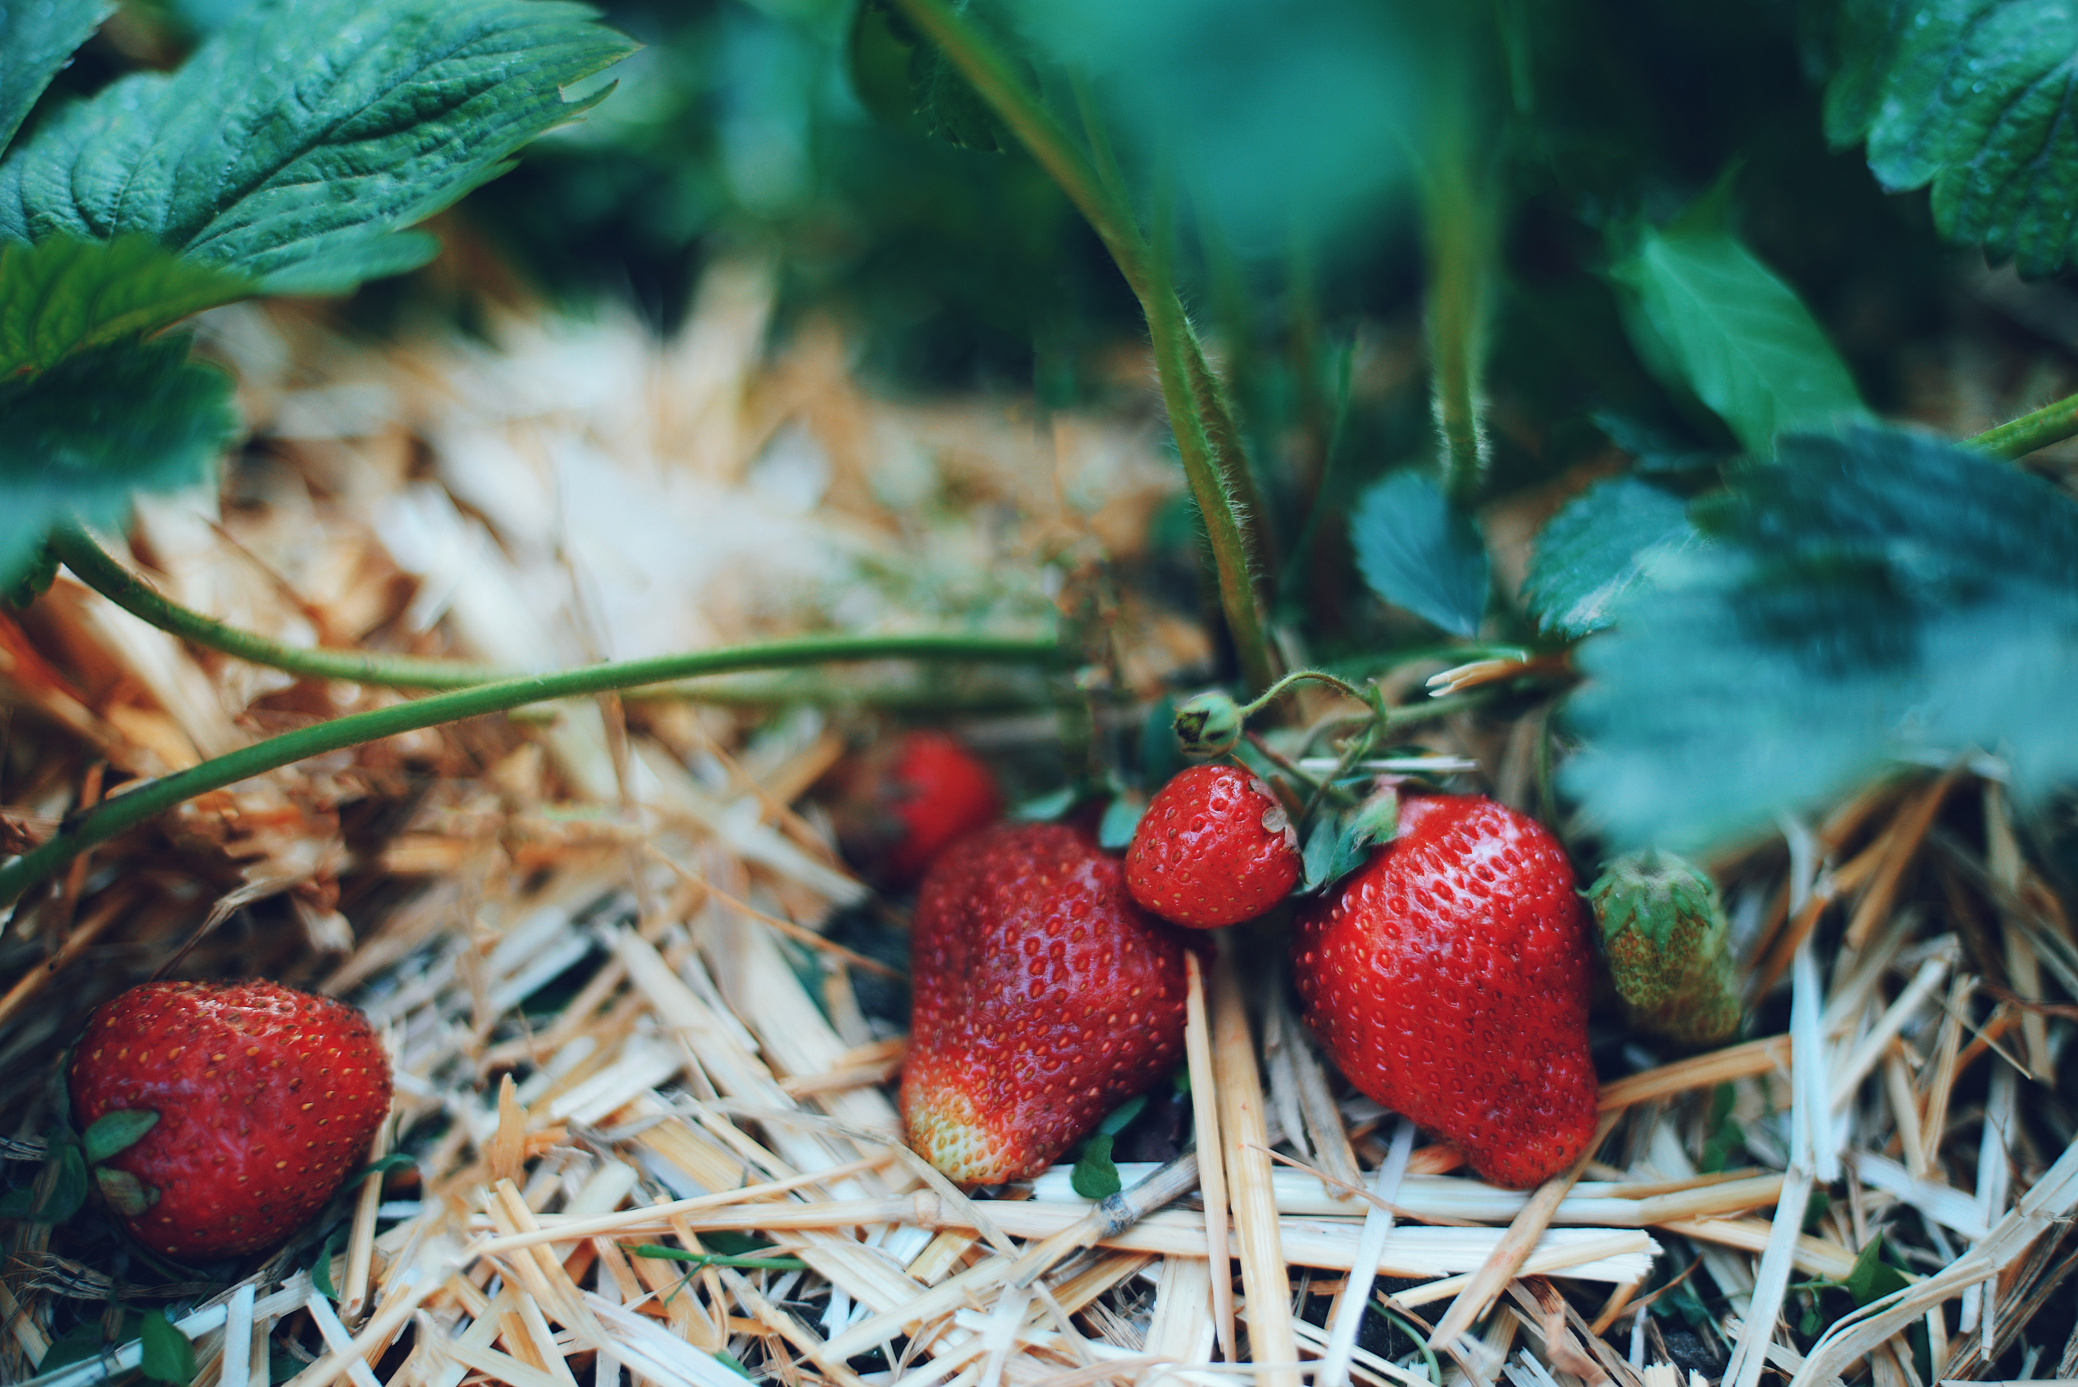
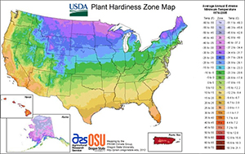
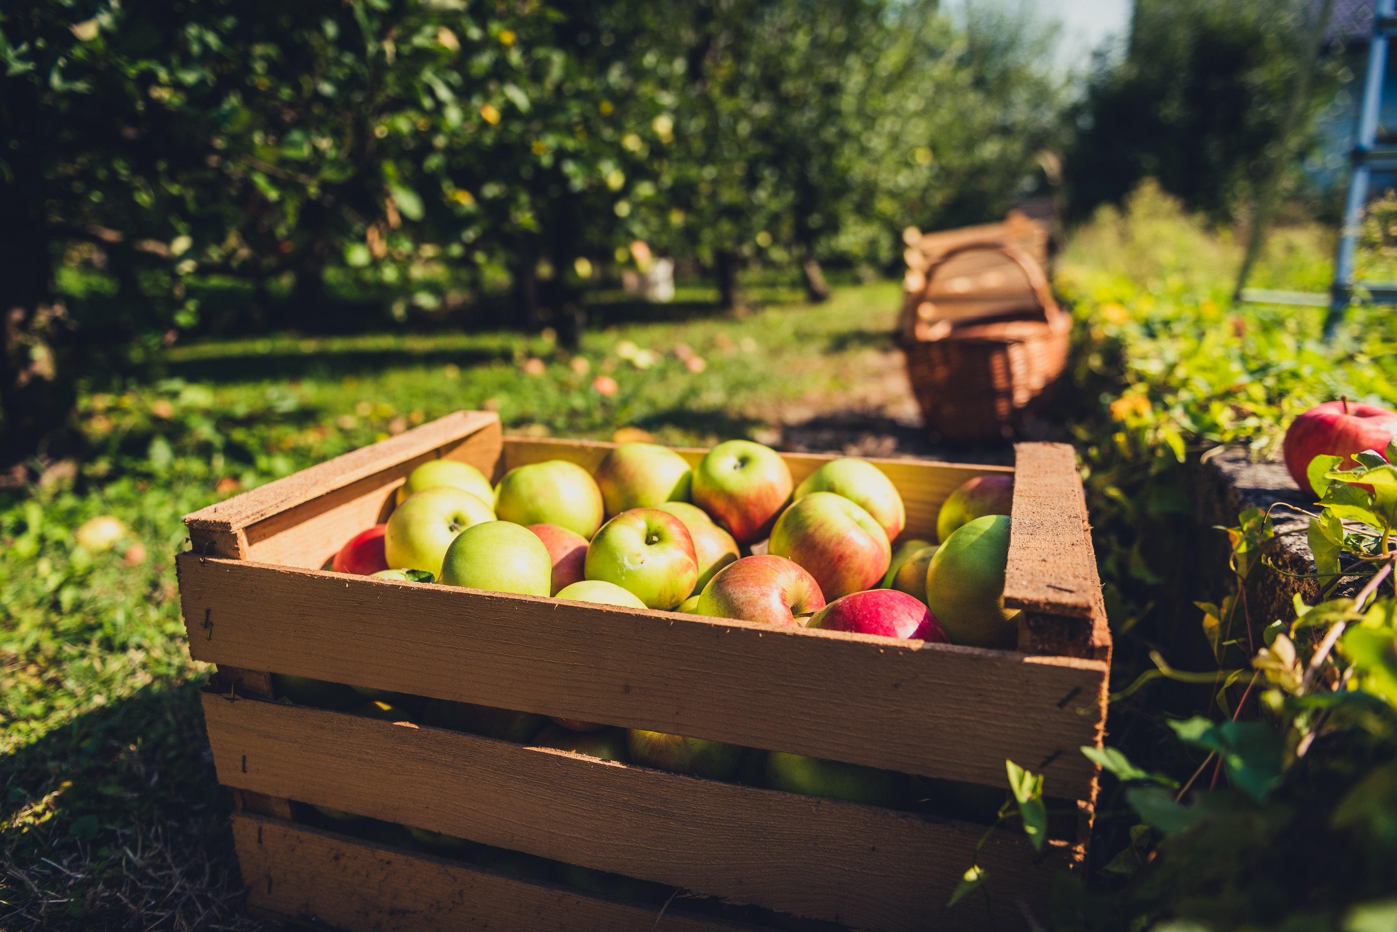
ZIP Code Search
Gavin Cyr

Slide 9
ZIP Code Search Functionality
Purpose & Features
How it Works:
Allows users to get a single ZIP code's zone, subzone, and temperature range of that zone
Search by ZIP code
Search ZIP code and look for plants in that zone
The user enters a ZIP code
The user data is pulled from the page and checked for criteria
A URL is built based on the entered information
Data is requested
Data is retrieved and processed into a table format
Table is sent to the webpage for display

Slide 10
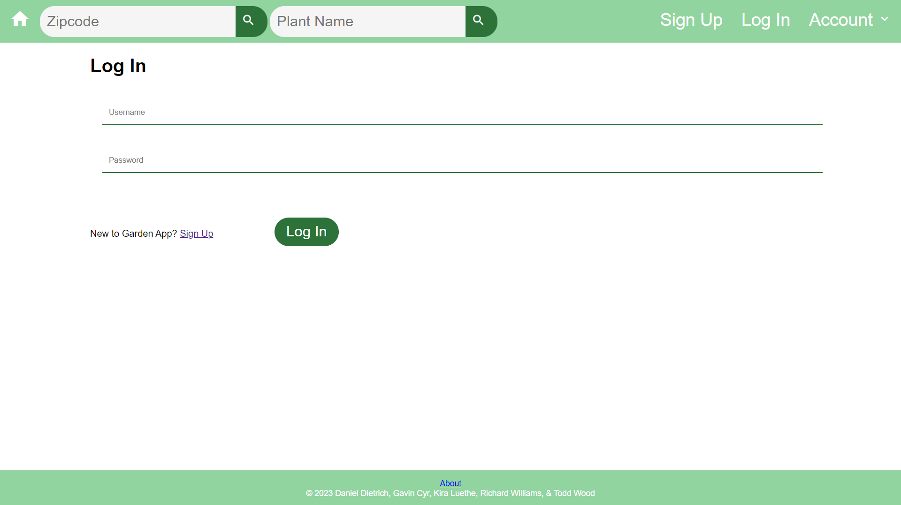




User Authentication
Daniel Dietrich

Slide 11
User Authentication Outline:
Features:
How It Works:
Secure Password Hashing.
Page Routing based on Authentication Results.
Initialization of Session Tokens upon Successful Authentication.
Destruction of Session upon Sign Out selection.
User enters Username and Password on Login Page.
Entered Password is hashed and stored User Password is retrieved from Database.
Passwords are compared.
If Username/Password combination is valid, Session Tokens are initialized, and User is redirected to Account Information Page.

Slide 12


Thank you

